Slide 1

The Effectiveness of NSSL's EXPERIMENTAL Warn-on-Forecast System for Severe Weather and Flash Flooding Events in The Carolinas in 2020-2021
Natalie Vernon
Valparaiso University
Meteorology
Weather Ready Nation
NWS Columbia, SC
Frank Alsheimer
08/05/2021

Slide 2
Outline
Objectives
Background
Methodology
Results
Summary
Next Steps
Acknowledgements
Notes:
Don’t read out, give them a few seconds to read.

Slide 3
Objective
Some of the most frequent hazards for NWS offices in the Carolinas are related to severe convection.
Severe wind gusts, large hail, tornadoes, and flash floods
Existing tools, such as doppler radar and in-situ observation, give warning times on average 10-20 minutes ahead of severe weather for an affected location
The goal of this project was to look at the effectiveness of the Warn-on-Forecast system in predicting these hazards in the Carolinas and potentially providing longer lead time to the partners.

Slide 4
Warn-on-Forecast System
The Warn-on-Forecast (WoF) research project is being run by NOAA’s National Severe Storms Laboratory (NSSL).
It is a limited domain convection-allowing ensemble analysis and forecast system
The WoF is designed to provide short-range (0–6 hr) guidance for thunderstorm hazards.
Notes:
Limited domain is the area in that the map covers, so a few states.

Slide 5
Model Configuration
WoFS 3 km | WoFS 3 km
Forecasts | 18 members, 6-h at top of the hour, 3-h at bottom of the hour
Model Core | WRF-ARW v3.9 (WPS3.7.1)
Domain | On-demand, smaller regional
Grid Points | 300 × 300 × 50
Grid Spacing | 3 km
Initial/Boundary Conditions | HRRRE
Data assimilation | 36 members, 15-min cycling with radar, satellite, surface observations
Microphysics | NSSL 2-moment
Shortwave and longwave radiation | Dudhia/RRTMG or RRTM/RRTMG
Planetary boundary layer | YSU, MYJ, or MYNN
Land Surface Model | RUC
Courtesy of Christopher Kerr
Notes:
300x300 is area and 50 is vertical levels
18 members that are unique combinations of the radiations and PBL

Slide 6
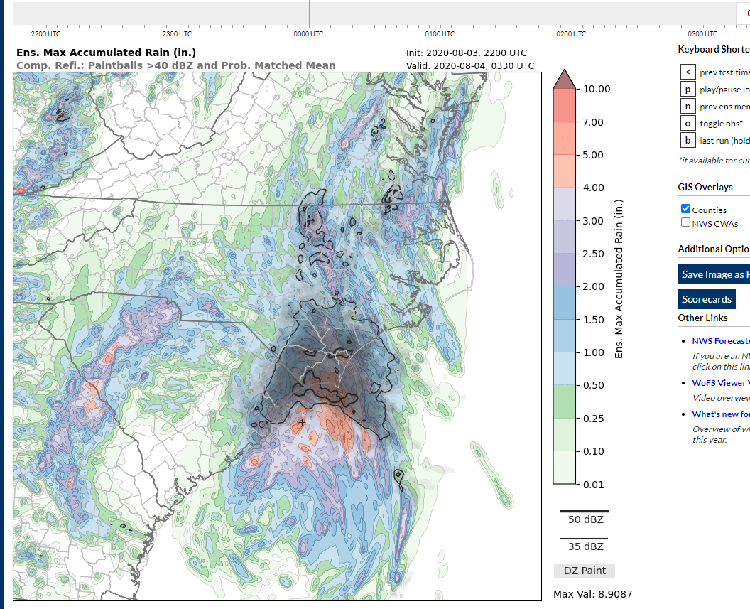
Methodology
Examined the Warn-on-Forecast System to find dates that the Carolinas were in the forecast area
Gathered the storm reports for those dates for the CWAs in the Carolinas
Notes:
Max Percentile Rain- 8/03/2020 at 21:00
Use this slide to explain how were determined the dates by looking at the limited domain to see if it was in the Carolinas

Slide 7
Dates | Offices
4/29/2020 | Columbia (CAE)
5/05/2020 | Wakefield (AKQ)
5/06/2020 | Charleston (CHS)
5/18/2020 | Wilmington (ILM)
6/15/2020 | Newport/Morehead City (MHX)
6/16/2020 | Greenville/Spartanburg (GSP)
8/03/2020 | Raleigh (RAH)
8/06/2020 | Blacksburg (RNK)
8/12/2020
8/15/2020
9/16/2020
5/03/2021
5/04/2021
5/05/2021
5/28/2021
Notes:
Offices that have some forecast area in the Carolinas were used in project.

Slide 8
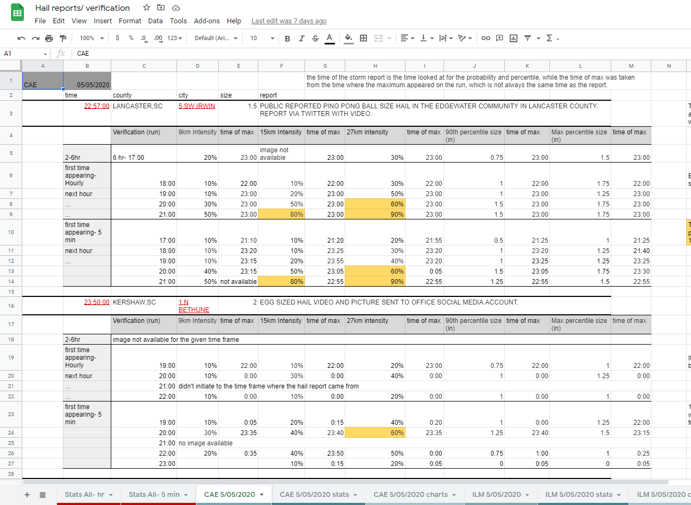
Methodology
Examined the different parameters on the Warn-on-Forecast system that correlated with the specific type of report
Values were placed into spreadsheets, where they were made into graphs and the average values were calculated
Notes:
Could mention that we were planning on looking at tornadoes and their parameters, but we did not have a large enough sample size or time.

Slide 9
Parameters
Parameter | Probabilities | Percentiles
Total accumulated Rainfall | ½”, 1”, 2”, 3”, 5” | 50%, 90%, Max
One Hour Accumulated Rainfall | ½”, 1”, 2” | 50%, 90%, Max
Three Hour Accumulated Rainfall | 1”, 2” 3”
Six Hour Accumulated Rainfall | 2”, 3”, 5”
Max Hail >1” | 9km, 15km, 27km | 90%, Max
Max Hourly Hail >1” | 9km, 15km, 27km | 90%, Max
Max Six Hour Hail >1” | 9km, 15km, 27km | 90%, Max
Max Surface Wind | 3km, 15km, 27km | 90%, Max
Max Hourly Surface Wind | 3km, 15km, 27km | 90%, Max
Max Six Hour Surface Wind | 3km, 15km, 27km | 90%, Max
z
Notes:
Not all that the WoF looks at, just a list of the ones that were looked at for this project.

Slide 10
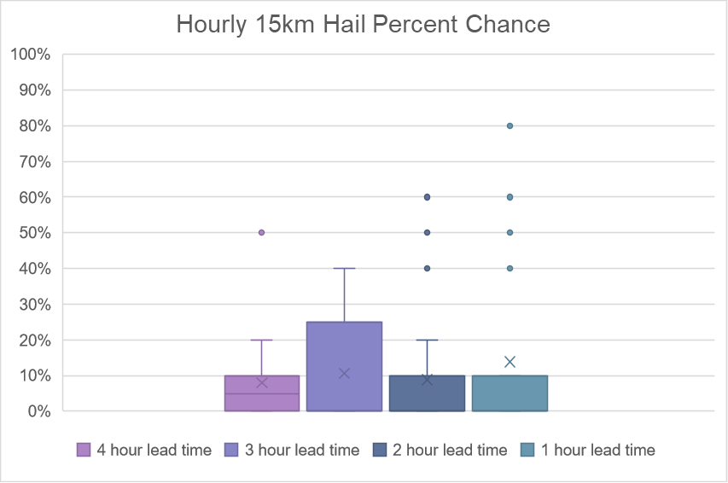
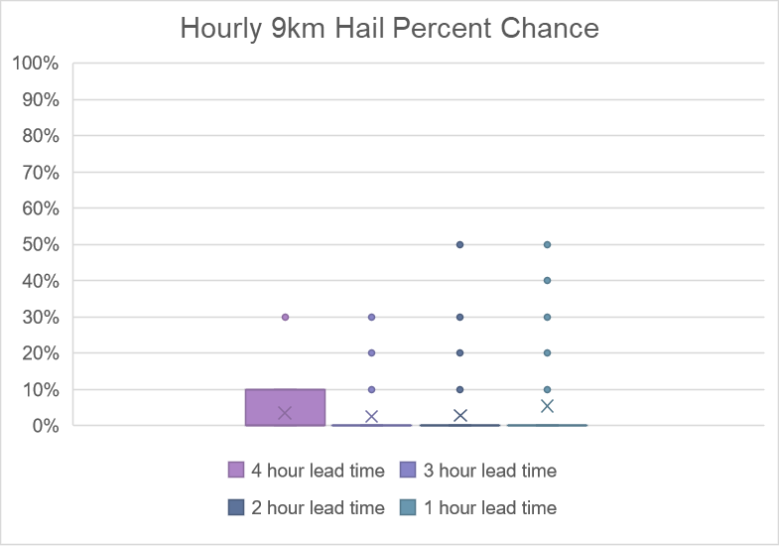
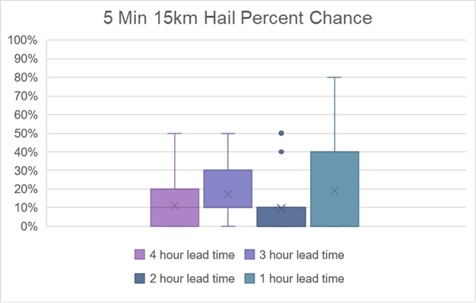
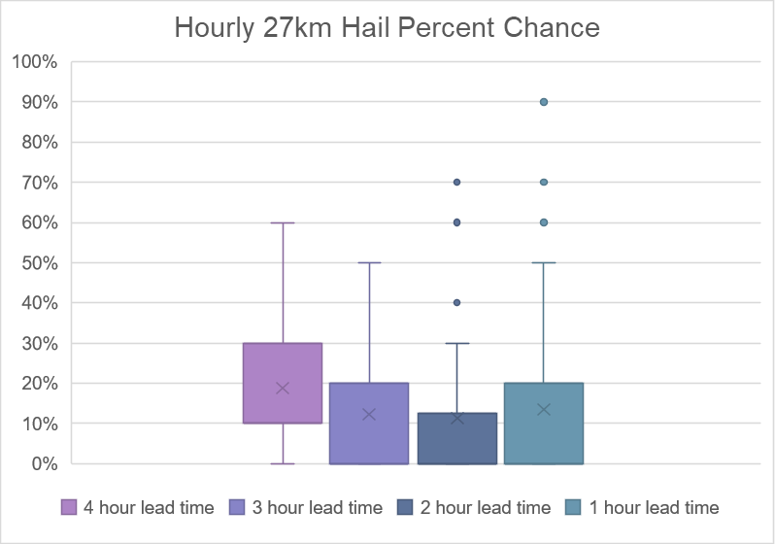
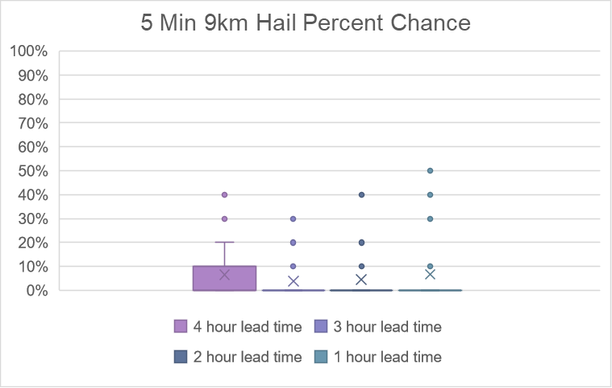
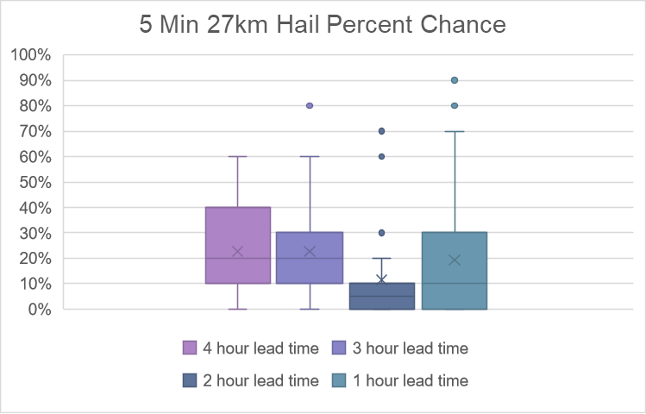
Notes:
Slide has animations
There wasn’t much difference between the hourly and the 5 min graphs.
The 9km grid had some cases of success but not a lot, as grid increased the WoF had a better chance at catching event

Slide 11
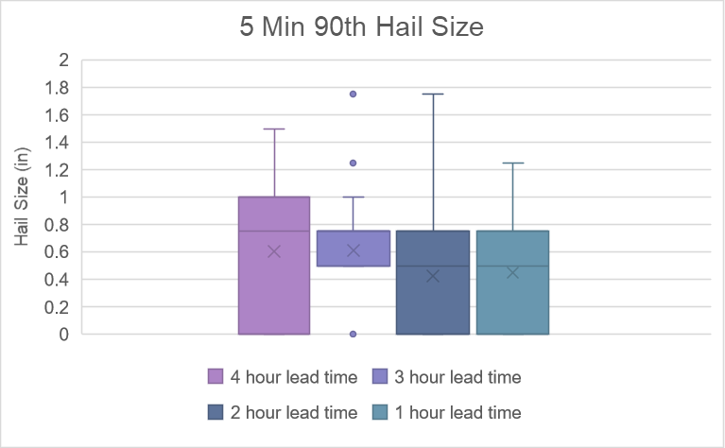
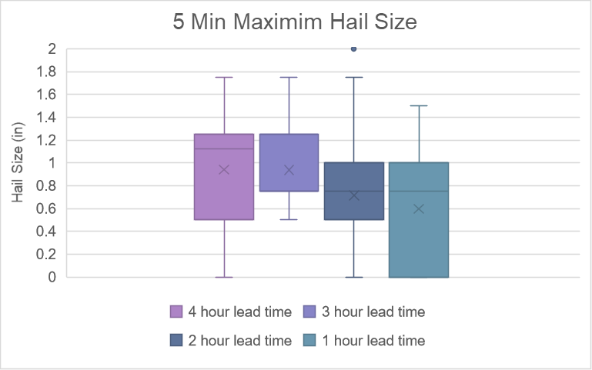
Notes:
Point out mean size for these charts,
Hourly had similar graphs

Slide 12
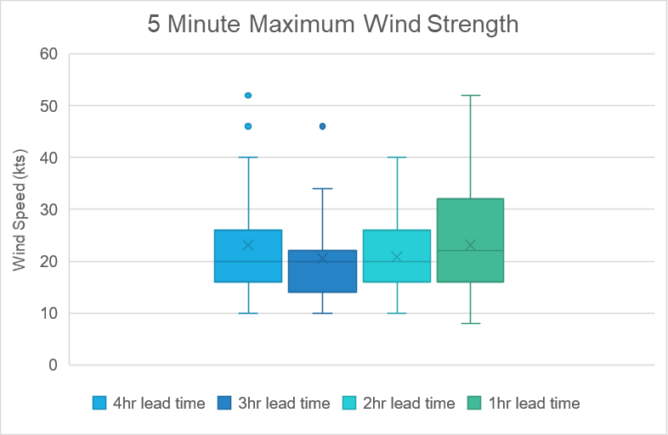
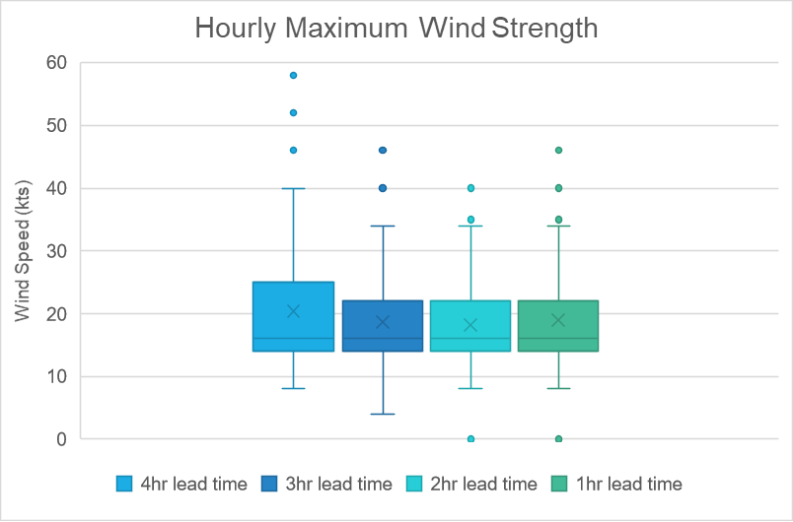
Notes:
Model can show which cells will have the strongest wind but can not tell the true strength of them. Because it tends to underestimate the winds.

Slide 13
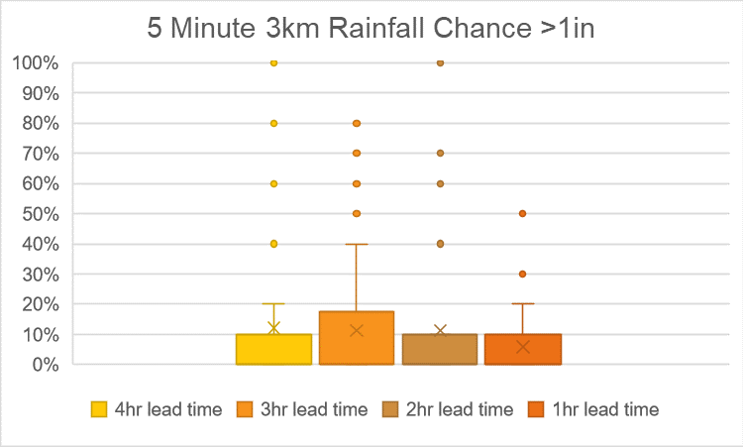
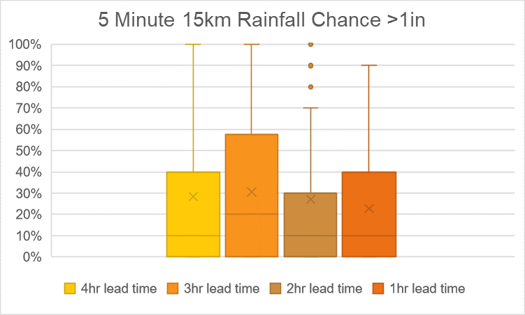
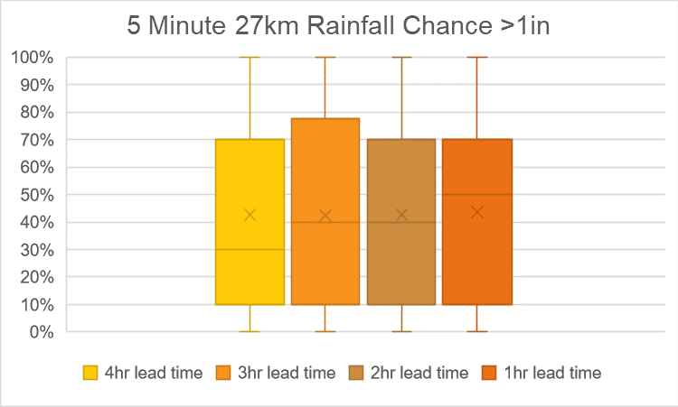
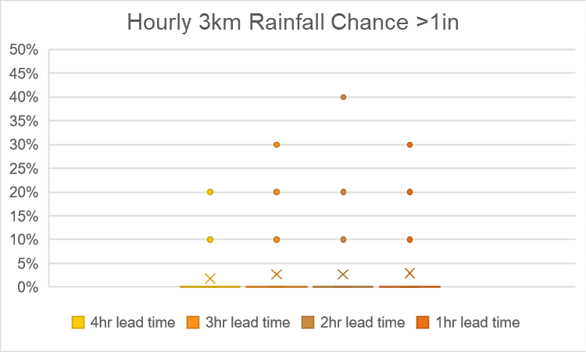
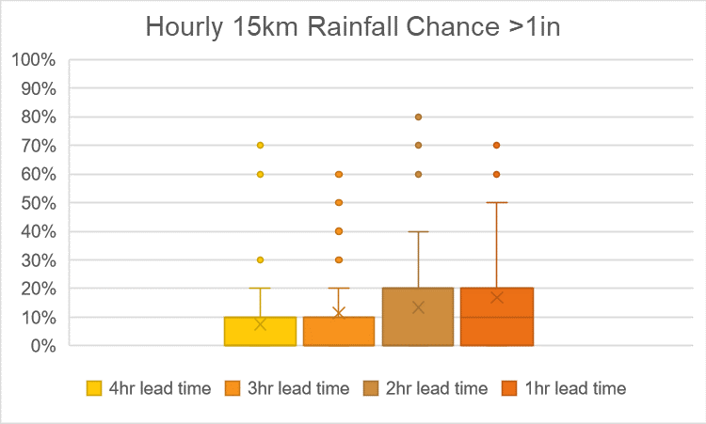
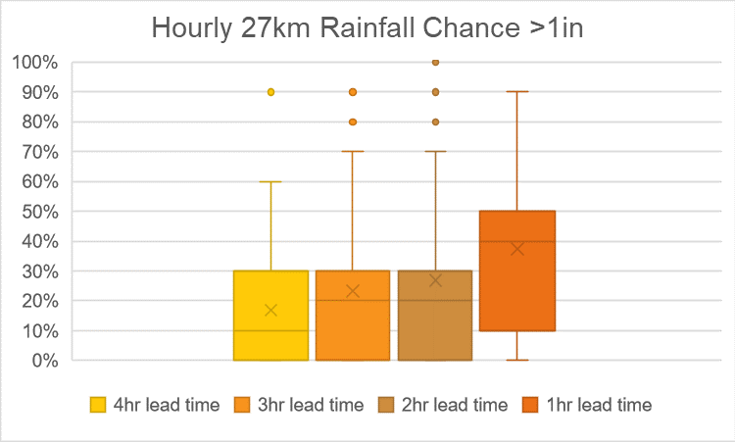
Notes:
The 27km grid picks up more chance of rain.
Since the 5 min is cumulative, it shows that there is a chance that this will happen by the end of the run, where as the hourly is not cumulative so can give a better time estimate to when it will be happening.

Slide 14
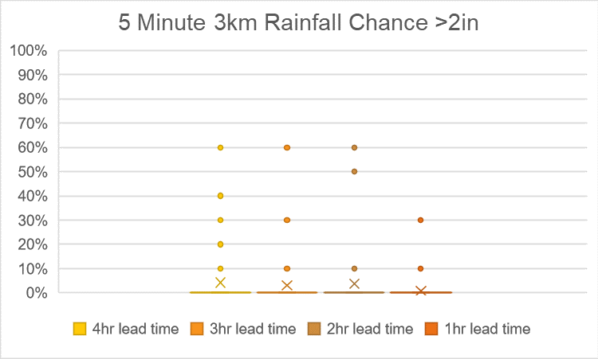
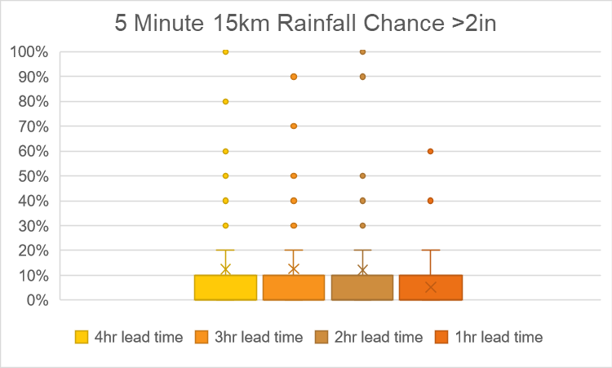
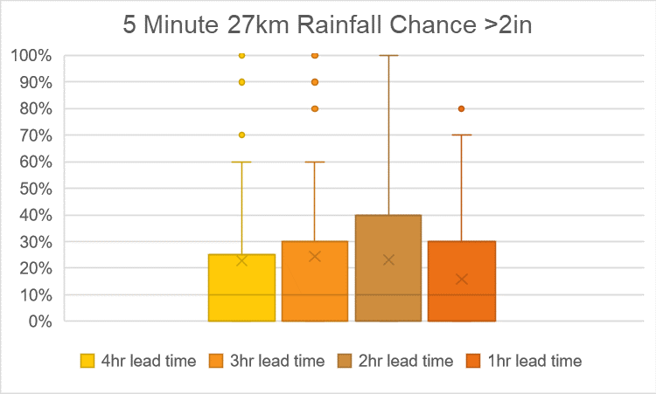
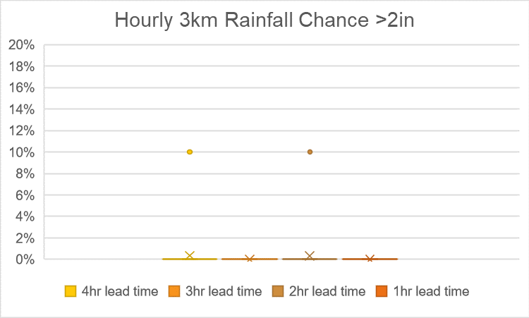
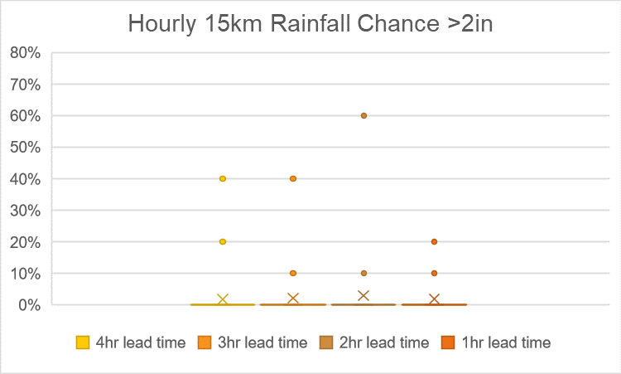
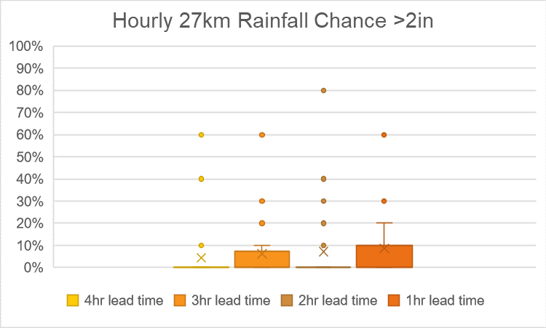

Slide 15
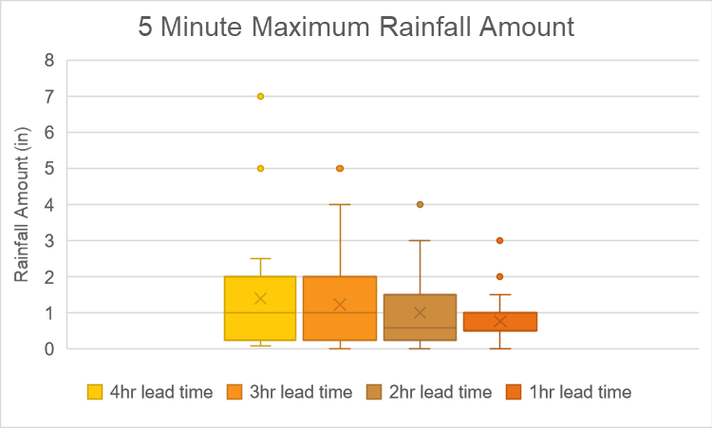
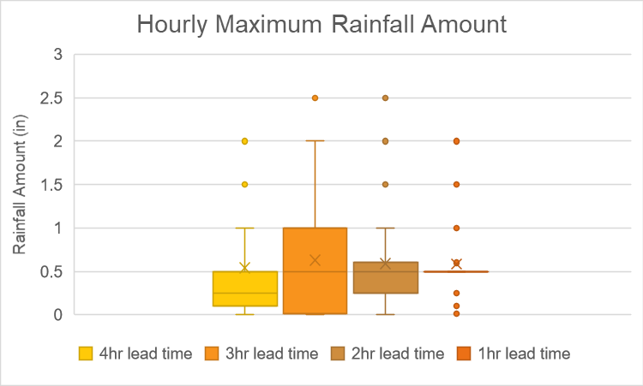
Notes:
Note that the 7in report for 5min will be in the example in a few slides.

Slide 16
Example- 8/06/2020
North Carolina/ Virginia
The SPC has a marginal risk over South Carolina, North Carolina, and Virginia.
5% wind risk
The NHC archives show no tropical disturbances or cyclones
There is a marginal risk of excessive rainfall over North Carolina, South Carolina, and Virginia.

Slide 17
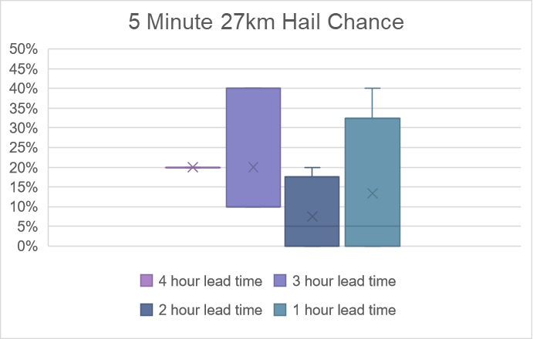
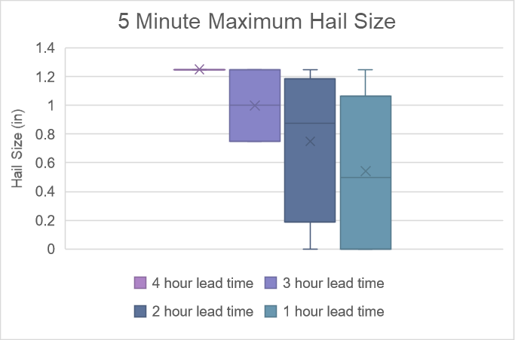
Example- 8/06/2020
Hail-
WoF slightly underestimated the size of the hail.
The percent chance was low for all but a couple of reports
A few reports had no data in the area on the model, however the model predicted that hail in the surrounding counties.
Notes:
Graphs have animation

Slide 18
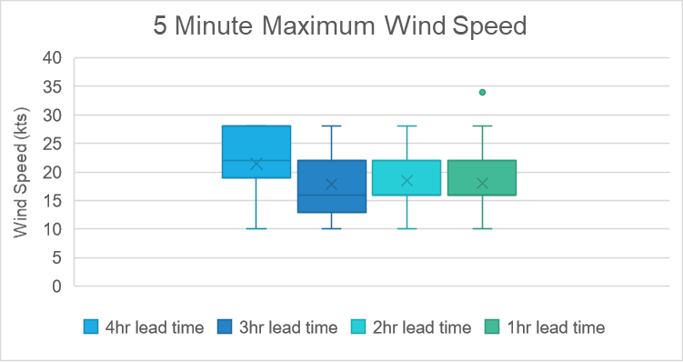
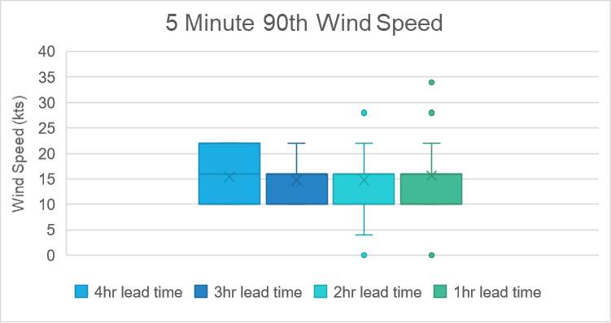
Example- 8/06/2020
Wind-
Winds were typically underestimated in the WoF. Speeds do not match up with reported winds and damages caused by these winds.
Additionally, WoF did not have percent chance for the winds.
Notes:
Slide has transitions in graphs
The lack of percent chance could be because the model did not predict winds above the severe criteria.

Slide 19
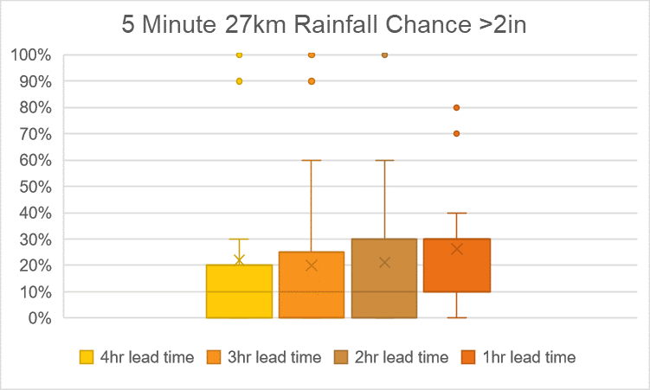
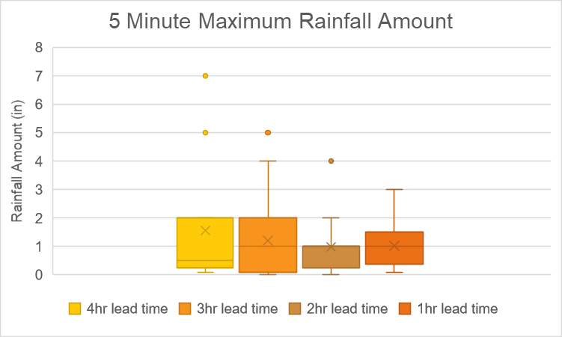
Example-8/06/2020
Flash Flooding-
Earlier reports for this date are less accurate than later reports.
Amounts and percent chance are a little underestimated, but sometimes they predicted the correct amount or more.
Notes:
Graphs have animations
Hard to consider amounts as some reports give totals while others do not

Slide 20
Additional Thoughts
Different functions that may improve the user interface for operational use
Zoom function
Ability to make the dBZ more transparent or turn off
Notes:
Weather Forecaster not weather observer

Slide 21
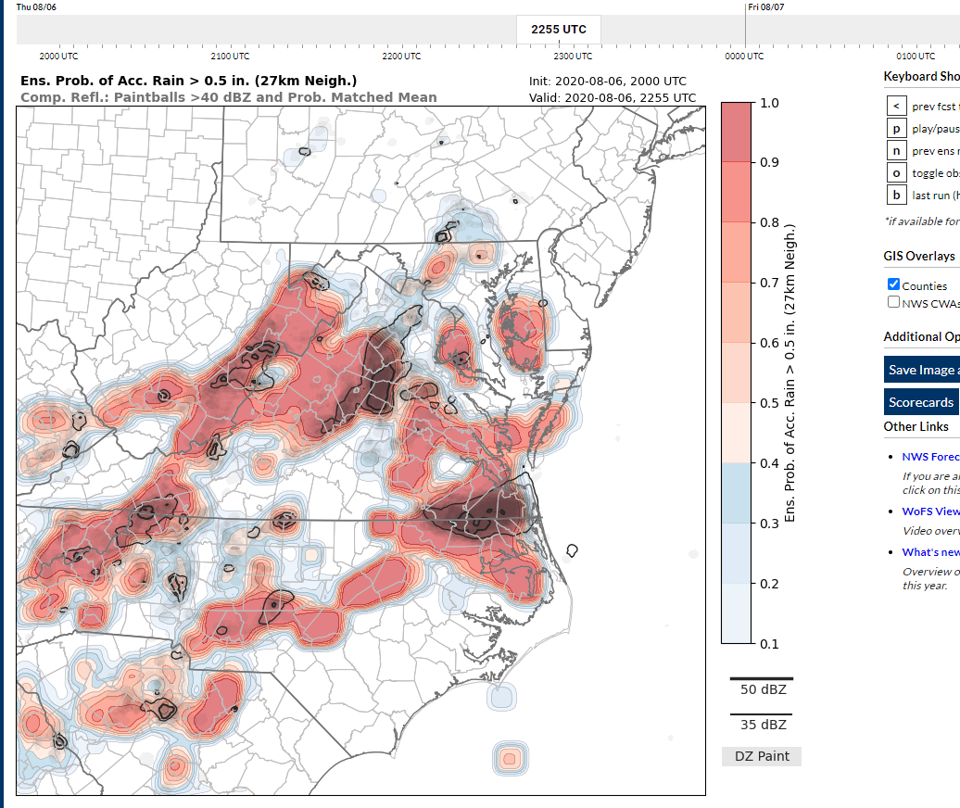

Slide 22
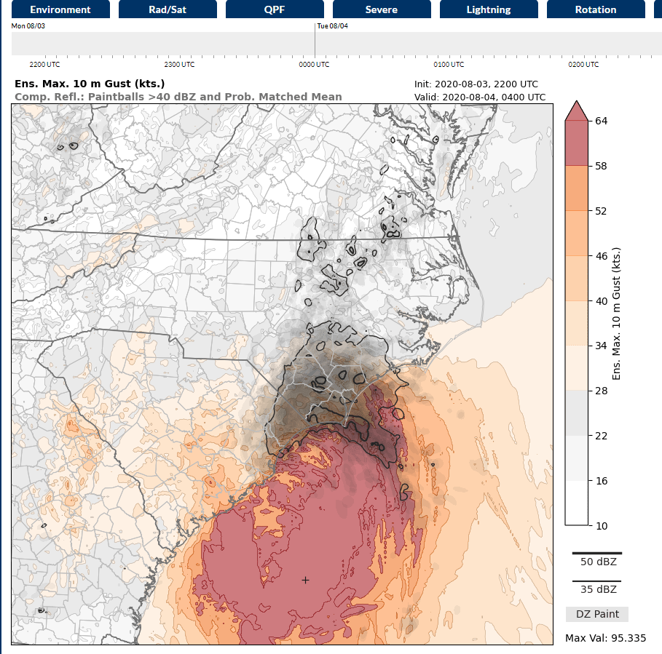
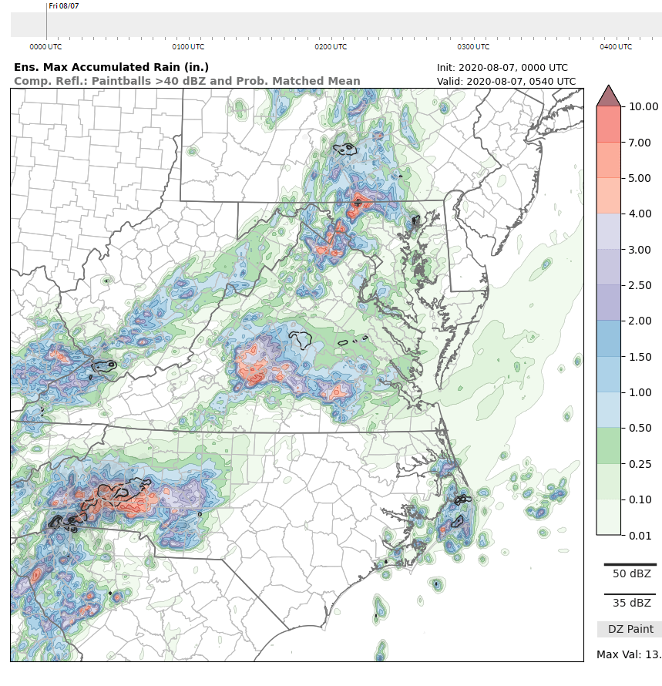
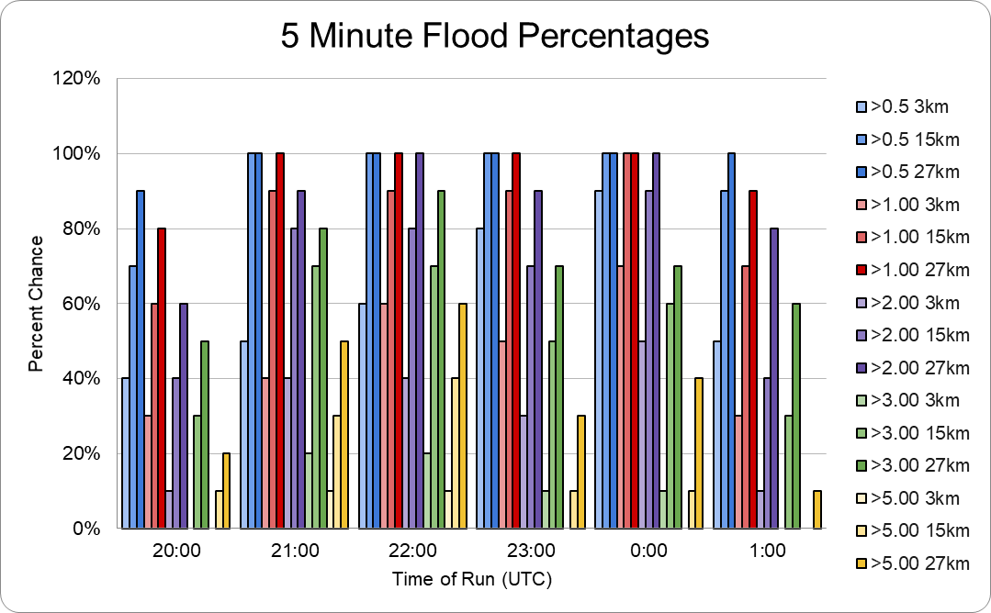
Summary
Hail parameters were good at forecasting the size and the percent chance for hail
Wind parameters were not as well forecasted
Few “percent chance” data appearing in the model
Wind values smaller than what would be expected for that event
Rain parameters did a decent job at predicting amount and the percent chance of rain
Notes:
Could substitute top pictures out for more graphs

Slide 23
Next steps
Examining the remaining parameters as well as looking into the model’s capabilities of predicting tornadoes
Investigating model runs for other areas and how well it forecasts different factors there.

Slide 24
Work Cited
https://wof.nssl.noaa.gov/realtime/?model=wofs&product=uh_2to5_90&sector=wofs
https://mesonet.agron.iastate.edu/cow/

Slide 25
Acknowledgments
Thank you to my mentor Frank Alsheimer for helping me and guiding me along in this research project and thank you to the staff at the NWS office in Columbia, SC, for letting me spend my summer learning from you, even if I could not be there in person. I would also like to acknowledge and thank Christopher Kerr, from NOAA/NSSL Norman, OK, for helping with the WoF as well as running additional dates through the system for this project.
Additionally, I would like to thank the NOAA Ernest F. Hollings Scholarship for funding this project and letting me take part in this amazing opportunity

Slide 26

Here is a QR Code to access the spreadsheets with the data and graphs.

Slide 27
Extra Graphs
For comparison between hourly & 5 min

Slide 28

Notes:
These slides to the end of presentation incase someone asks about comparison

Slide 29
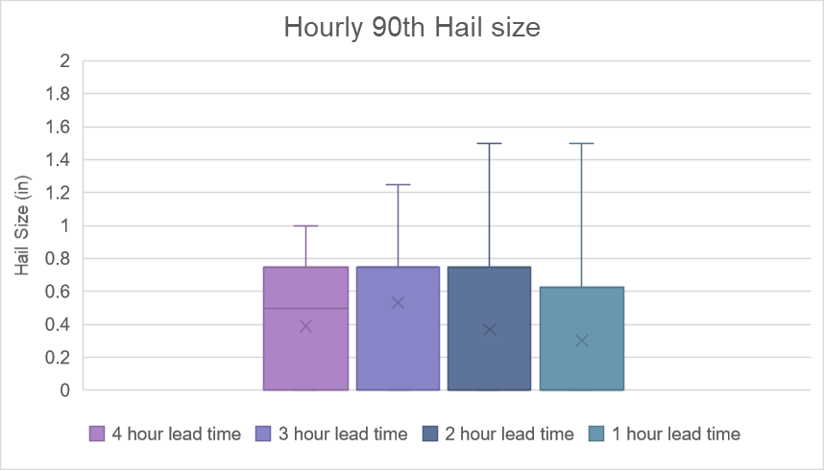
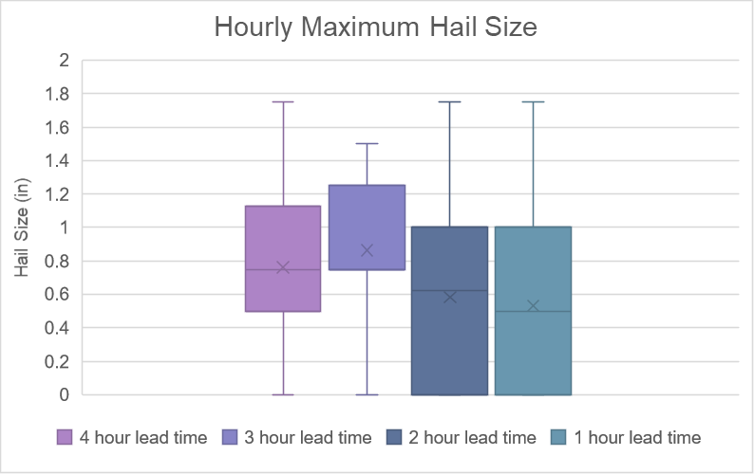
Notes:
These slides to the end of presentation incase someone asks about comparison

Slide 30
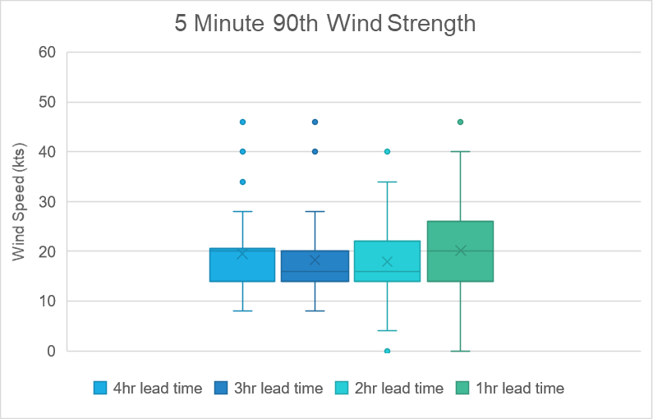
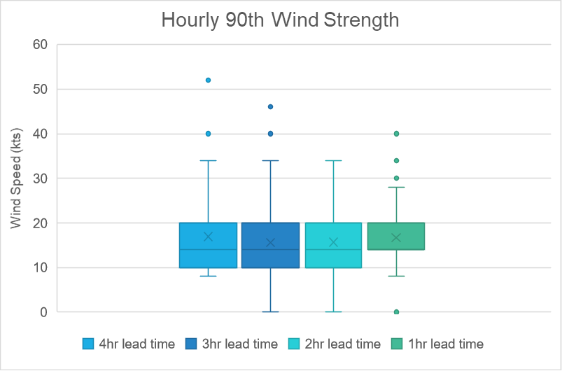
Notes:
These slides to the end of presentation incase someone asks about comparison

Slide 31
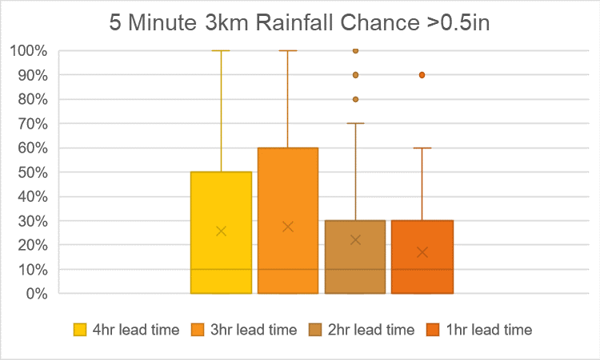
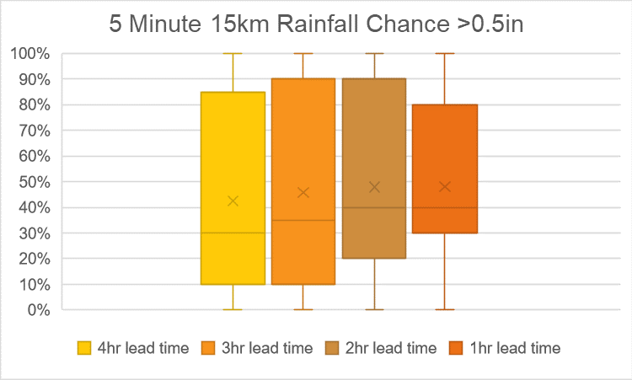
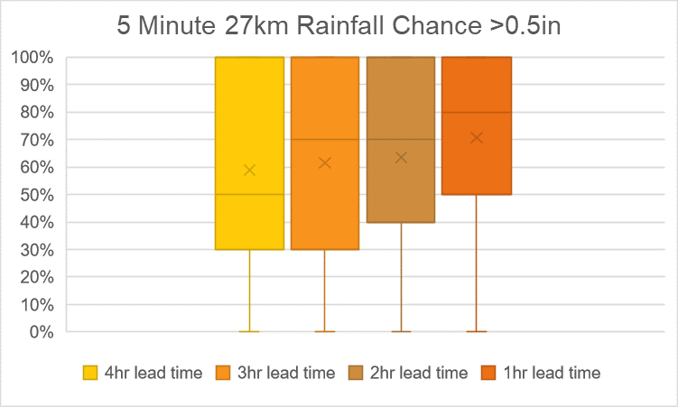
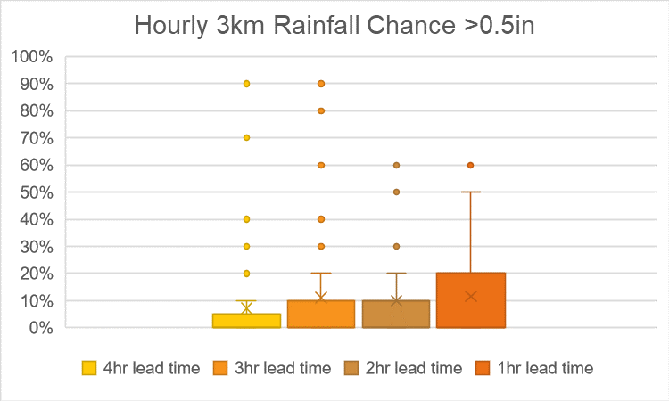
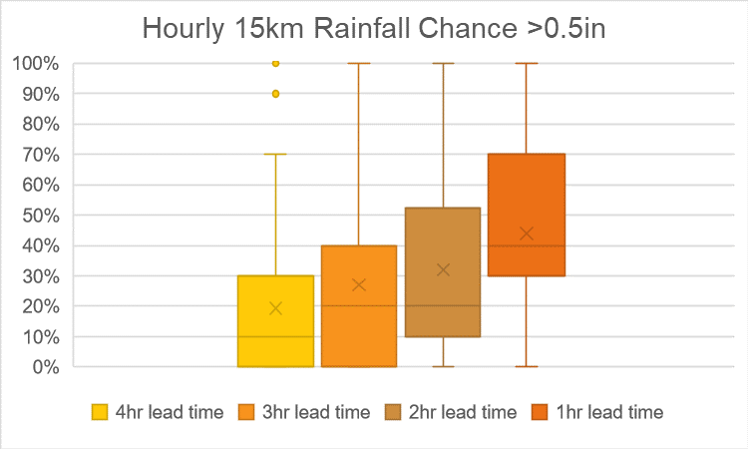
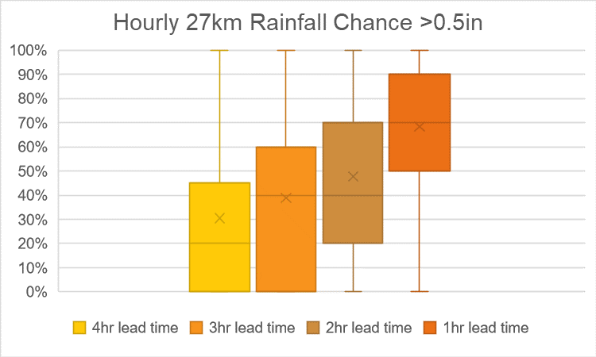
Notes:
These slides to the end of presentation incase someone asks about comparison

Slide 32
Notes:
These slides to the end of presentation incase someone asks about comparison

Slide 33
Notes:
These slides to the end of presentation incase someone asks about comparison

Slide 34
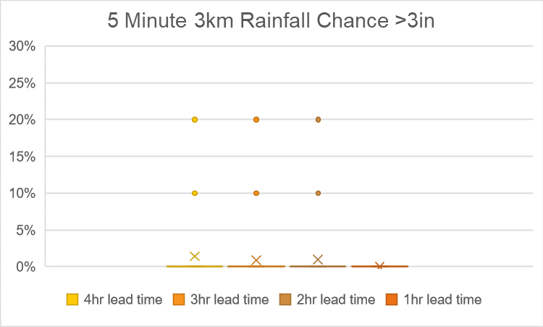
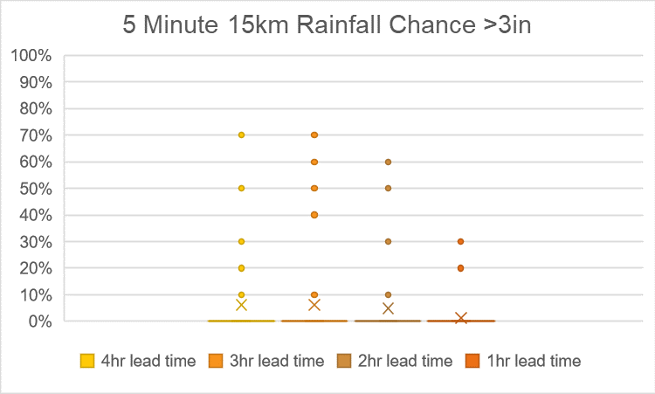
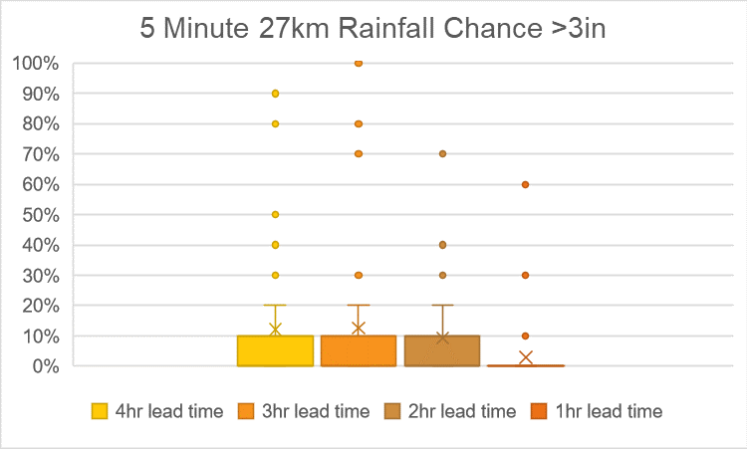
Notes:
These slides to the end of presentation incase someone asks about comparison

Slide 35
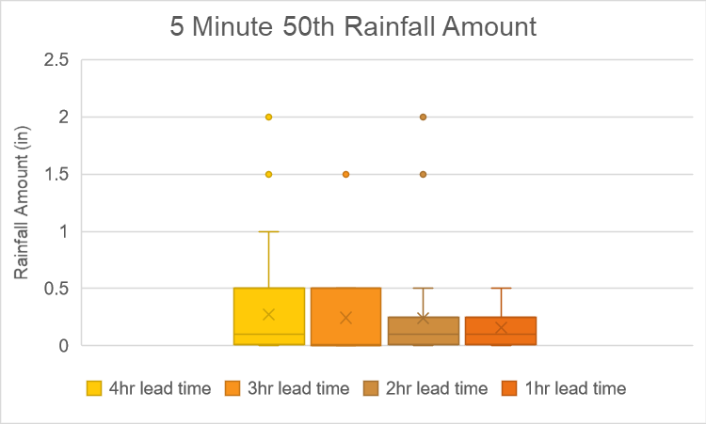



Notes:
These slides to the end of presentation incase someone asks about comparison

